Slide 1
Medieval India
The Tripartite Struggle

Slide 2
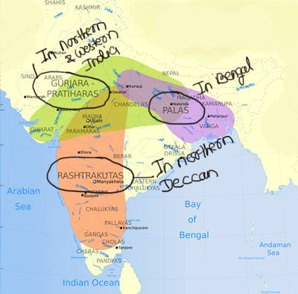
BETWEEN THREE KINGDOMS

Slide 3
WHY THIS CONFLICT?
THE REASONS
To get control over the rich resources of the Gangetic valley.
To acquire supremacy over Kannauj, as a symbol of prestige.
For the booty, thus gained to maintain the army.
To control Gujarat and Malwa whose nearness to the coast helped trading.
Kannauj was located on the Ganga trade route and was connected to the Silk route. This madeKannauj strategically and commercially very important.
Kannauj was also the capital city of Harshvardhan’s empire in North India.

Slide 4
THE RESULT OF THIS STRUGGLE
This struggle lasted for two centuries and made all dynasties weak in the long run. The struggle resulted into the political disintegration of the country and benefited the Islamic invaders from Middle-East. In the end the GurjarA-Pratiharas won in the struggle.

